Slide 1
The Art of Model Transformation with Operational QVT
Sergey Boyko
Radomil Dvorak
Alexander Igdalov
Borland Software Corporation

Slide 2
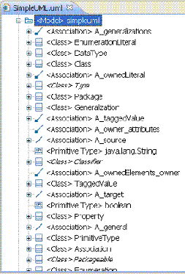
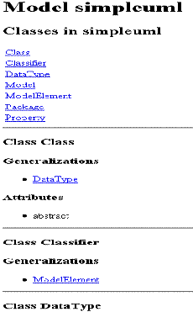
Generating Documentation
Create XHTML documentation for the simple UML model
  Input: UML model with classes - Output: XHTML document
M2M
UML metamodel: exists
XHTML metamodel: generate from XSD

Slide 3
Generating Documentation
Use existing XSDs to generate EMF metamodels
  Generate EMF metamodel from XSD, deploy
  Write transformation against the new metamodel
Example: create HTML documentation for the simple UML model
  xsd from http://www.w3.org/2002/08/xhtml/xhtml1-strict.xsd
  Changes to xhtml.ecore
  Generate model, deploy
  Launch new application, check xhtml model in “Metamodel Explorer”
  Start QVTO transformation
Notes:
- task definition: generate javadoc-like documentation outlining simple UML model
- wants to use existing M2M transformation approach to prototype such engine
- possible solution is to use XSD part of EMF to achieve that remaining with M2M

Slide 4
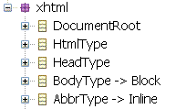
UML to XHTML Example
Start with empty XHTML document
  Typical document contains
The HTML element representing document itself
The document head
The HEAD element
The TITLE element
The document body
The BODY element
Highlights:
  Create document's skeleton in main()
  XSD-backed model requires instance of DocumentRoot as a root element
  Modify xhtml.ecore to allow access to text parts of mixed references

Slide 5
UML to XHTML Example
List all classes containing by the model
  In XHTML that list represents as follows
<div>
<h2>Classes in simpleuml</h2>
<table>
<tr>
<td>Association</td>
</tr>
<tr>
<td>Class</td>
</tr>
.....
</table>
</div>
mapping Class::class2row() : TrType
  UML classes is requested by (preserving lexical order on class names)
  query Package::allClasses() : OrderedSet(Class)

Slide 6
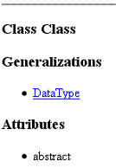
UML to XHTML Example
Describe each UML class
UML Class
|
|-[*] generals
|
|-[*] attributes
mapping Class::class2div() : DivType
mapping
Generalization::gen2listitem() : LiType
mapping
Property::attr2listitem() : LiType
Highlights:
  evolve allClasses() query to mapping for achieving singleton behavior
  filter empty generals/attributes sections by means of mapping guard ("when" clause)

Slide 7
UML to XHTML Example
Beautify XHTML document
  Add cross references
<a href="#simpleuml.Enumeration">Enumeration</a>
Reference to
<div id="simpleuml.DataType">class description</div>
  href id is created by means of recurrent fullName() query
Workflow examination
  console debug output (appearance controlled with configuration property)
  mapping preconditions with asserting

Slide 8
Transformation composition
Compose just create transformation with the previous one
  Chain Ecore2Uml with Uml2Xhtml
    Chain by means of QVTO transformation's instantiation
      var t : Transformation := new Uml2Xhtml(Uml, Xhtml);
      var s : Status := t.transform();
    Chain by means of Ant script (QVT Operational Help gives an example)
      <qvto:transformation
      uri="transforms/Uml2Xhtml.qvto“
      >
      …

